Slide 1
TERRE Trans European Replacement Reserves Exchange
Stakeholder Workshop to exchange on the
public survey about the increase of the number of clearings in the RR process
7th June 2023

Slide 2
Agenda
TERRE Stakeholder Workshop to exchange on the public survey about the increase of the number of clearings in the RR process
# | TOPICS | Timing (CET)
1 | Introduction | 10:05
2 | Comparison of possible future design of RR process | 10:20
3 | Conclusion and questions | 11:00
4 | Questions & Answers | 11:30
 | End of the meeting | 12:00

Slide 3
1. Introduction

Slide 4
Introduction
Public survey organization
The proposed public survey has been launched on Monday 29th May and will end on Friday 30th June.
Public stakeholders are invited to read carefully the explanatory document and answer to the question of the survey.
It is proposed as a preliminary consultation to gather all public stakeholders’ feedbacks to select the best option. Another public consultation will follow to amend the Implementation Framework thanks to the chosen option
Link of the public survey: https://consultations.entsoe.eu/markets/rr_survey_clearings/

Slide 5
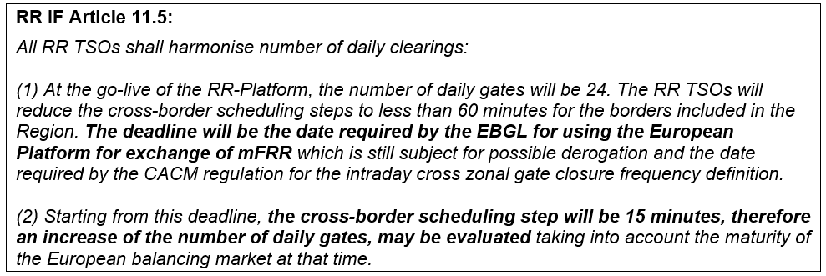
1. Introduction
Legal context
Today. the RR process consists of 24 daily gates with 24 clearings per day. This design was mainly chosen because at the time of the introduction of the RR platform. the cross-border scheduling step was 60 minutes on most borders.
According to the current IF, the cross-border scheduling step must be reduced to 15 minutes, on all borders. That would allow to increase the number of daily gates for the RR process.
Together with the reduction of the cross-border scheduling step, relevant market regulation also prescribes a combined reduction of the market time unit (MTU) and of the Imbalance Settlement period on both balancing markets and energy markets.

Slide 6
1. Introduction
Legal context
The RR platform already allows the use of a 15-minute MTU, while only performing 24 daily clearings. On the other hand, the number of daily gates for the cross-zonal intraday, which is also 24 at the moment, will increase to 96 gates in the future (as per the above Article of Reg.(EU) 2019/943). Also, as set by the following art. 24.2(b) of EBGL, the balancing energy gate closure time shall not be before the intraday cross-zonal gate closure time:
Therefore, the new number of intraday gates necessarily leads to the increase of the number of daily gates for the RR process.

Slide 7
1. Introduction
Conclusion and timeline
Conclusion
 | 24 RR gates | 48 RR gates | 96 RR gates
24 CZ ID gates | Compatible | Compatible | Compatible
96 CZ ID gates | Not compatible | Not compatible with CZ ID or conflict with MARI | Compatible
Only an RR process with 96 clearings is compatible with 96 gates on the cross zonal intraday market.

Slide 8
1. Introduction
Conclusion and timeline
Timeline
Public survey
Deliberation phase (with RR NRAs)
Public consultation for RR IF amendment
Work on technical implementation
29/05
30/06
≈ End of Sept/Oct
≈ End 2023/Q1 2024
≈ End 2024/Q1 2025
7/06
Public stakeholder workshop
July 2024
Deadline for CB SS to 15min
The timeline is an estimation, the aim to select the preferred option and work on the IF amendment by the end of the year

Slide 9
2. Comparison of possible future design of RR process

Slide 10
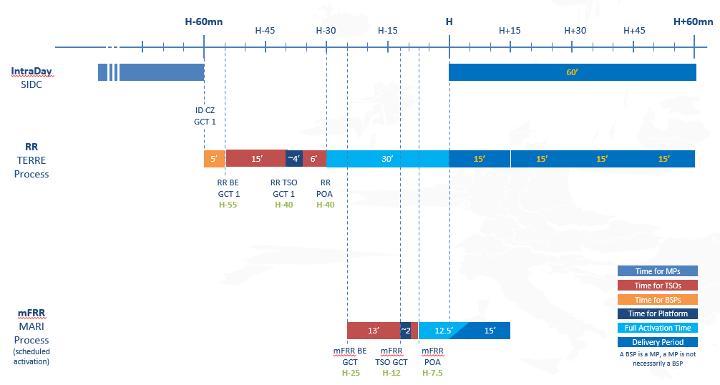
2. Comparison of possible future design of RR process
Current RR process
Key indicators
24 Gates per day (one every hour)
Each clearing is for four MTUs (4x15 min)
Full Activation Time (FAT) of 30 min
Balancing Energy Gate Closure Time (BE GCT) at H-55
Process time for TSOs 15min
Process time for LIBRA 4 min
Results communicated to BSPs at the latest at H-25
Granularity of Cross Border Marginal Price (CBMP) 15 min

Slide 11
2. Comparison of possible future design of RR process
Proposed options for the future RR process
Options proposed in the public survey for the future RR process
Option#1: 96-clearings with same timing with linking necessary
Option #2: 96-clearings with reduced timing with no linking
Option #3: 96-clearings with reduced timing but the possibility to have delivery period up to 30

Slide 12
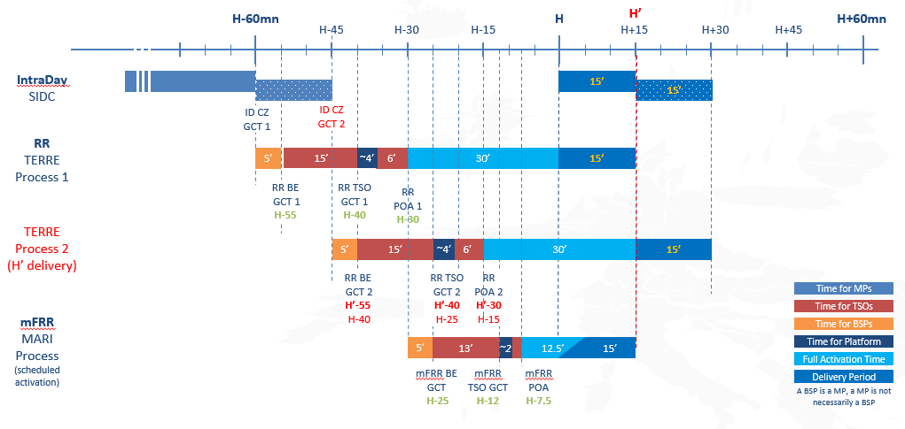
2. Comparison of possible future design of RR process
Option #1: 96 clearings with current timing
Key indicators
96 Gates per day (one every 15 min)
In each clearing, one MTU is computed (15 min)
FAT of 30 minutes
BE GCT remains at H-55
Process time for TSOs remains 15 minutes
Process time on LIBRA remains 4 minutes
Results communicated to BSPs at the latest at H-30
Linking of bids between clearings is necessary

Slide 13
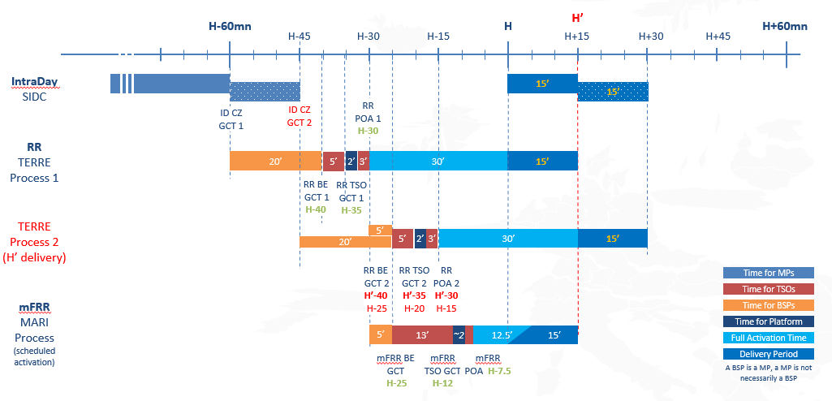
2. Comparison of possible future design of RR process
Option #2: 96 clearings with reduced timing
Key indicators
96 Gates per day (one every 15 min)
In each clearing, one MTU is computed (15 min)
FAT of 30 minutes
BE GCT is moved to H-40
Process time for TSOs is reduced to 5 minutes
Process time on LIBRA is reduced to 2 minutes
Results communicated to BSPs at the latest at H-30

Slide 14
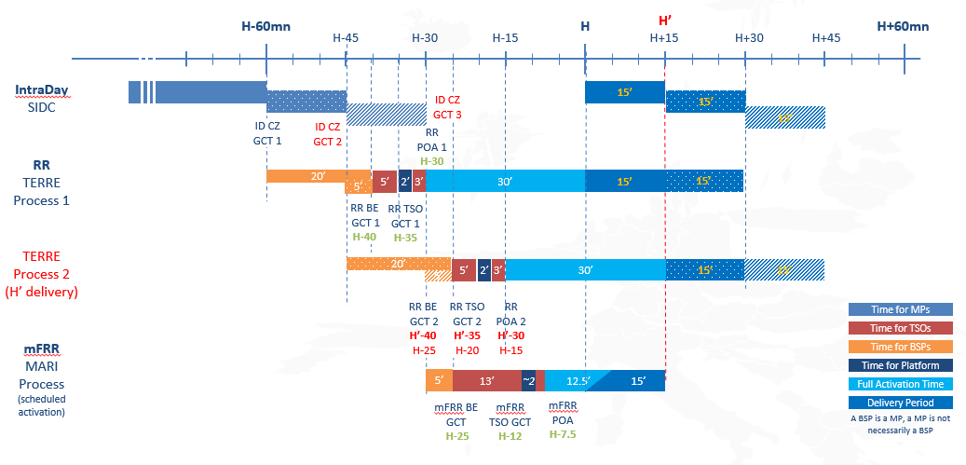
2. Comparison of possible future design of RR process
Option #3: 96 clearings with reduced timing and delivery period up to 30 minutes
Key indicators
96 Gates per day (one every 15 min)
In each clearing, 2 MTUs can be computed (2x15 min) but only some TSOs will submit bids and needs for the second MTU
Delivery period up to 30 minutes
FAT of 30 minutes.
BE GCT is moved to H-40
Process time for TSOs is reduced to 5 minutes
Process time on LIBRA is reduced to 2 minutes
Results communicated to BSPs at the latest at H-30

Slide 15
3. Conclusion and questions to answer

Slide 16
3. Conclusion and questions
Conclusion
Option | Pros | Cons
#1 96 daily gates with current timings | Aligned with target ID resolution and target XB scheduling step Time for process on LIBRA remains the same | 30min delivery period not possible, will reduce liquidity due to technical constraints Very similar process/product compared to MARI Scheduled Activation which allow arbitrage between MARI and TERRE for BSPs and less added value for operators BSPs need to make bids of next clearing without results of previous clearing. Does require the introduction of linking between clearings (same as in MARI)
#2 96 daily gates with reduced timings | Aligned with target ID resolution and target XB scheduling step Results of previous clearing are known, when BSP need to submit bids for next clearing. No linking needed. Simplified process. Balance energy gate closure is closer to real-time. | 30min delivery period not possible, will reduce liquidity due to technical constraints Very similar process/product compared to MARI Scheduled Activation which allow arbitrage between MARI and TERRE for BSPs and less added value for operators Less time for process on TSOs and LIBRA platform sides.
#3 96 daily gates with reduced timings and delivery period up to 30 minutes | Delivery period up to 30min possible for some TSOs. Increases the liquidity. Results of previous clearing are known, when BSP need to submit bids for next clearing. No linking needed. Balance energy gate closure is closer to real-time. | The usage of the RR process is not the same for all TSOs. There are two clearings for each MTU with possible arbitrage and reduced transparency. More complicated process. Less time for process on TSOs and LIBRA platform sides.

Slide 17
3. Conclusion and questions
Conclusion
The current RR IF prescribes, that all RR TSOs must reduce the cross-border scheduling step to 15 minutes. The deadline for this change is the date required by the EBGL for using the European Platform for exchange of mFRR.
The reduction of the cross-border scheduling step allows to increase the number of daily RR gates from today’s 24.
Such an increase of daily gates for the RR process is not only possible, but it is necessary in order to keep the RR process compatible with an increased number of daily gates in the cross zonal intraday market of 96 per day.
The analysis shows that only an RR process with 96 daily gates is compatible with the 96 gates of the CZ ID.
This necessary change of the RR process from 24 gates per day to 96 gates per day has to be done before the change on the CZ ID is done.
TSOs identified three possible designs for an RR process with 96 clearings per day:
Option #1: A process with 96 clearings, a maximum delivery period of 15 minutes and the same timing as today. This would require the introduction of linking between clearings
Option #2: A process with 96 clearings, a maximum delivery period of 15 minutes and a reduced process timing with no need to introduce a linking between clearings.
Option #3: A process with 96 clearings, a maximum delivery period of 30 minutes and a reduced timing. This option would only be available for some TSOs.
All three possible design options of the RR process have pros and cons. RR TSOs would therefore very much appreciate the feedback of all stakeholders on the options in order to select the more appropriate design for the future RR market. It is important to remind option #3 still has some open questions that should be resolved before selecting it for the evolution of the TERRE project. However, TSOs want to receive feedback from BSPs on whether they are interested or not in this solution.

Slide 18
3. Conclusion and questions
Questions
Questions of the survey
Option preference:
Which option is your preferred one? Please explain, in detail, your selection.
Impact on liquidity:
Is there an impact on your RR bids with the changes proposed in the final option? Please elaborate in detail.
Do you consider conditional linking necessary for option #1? Please elaborate why.
Will your availability to provide RR be affected with the reduction of the delivery period ? If so, please indicate to what extent for
Option #1 and #2 (reduction of maximum delivery period from 60 to 15 minutes)
Option #3 (reduction of maximum delivery period from 60 to 30 minutes)
Flexibility on timings:
Currently there are 5 minutes between ID GCT and TERRE GCT, would it be possible to shorten this timing (please provide an answer in minutes)?
Currently there are 5 minutes between TERRE results and MARI GCT, would it be possible to shorten this timing (please provide an answer in minutes)?
Other:
Do you have any other comments or proposals on the RRIF or on the RR process in general?

Slide 19
Any questions?

Slide 20
Thanks for your participation

Slide 21
Back-up slides

Slide 22
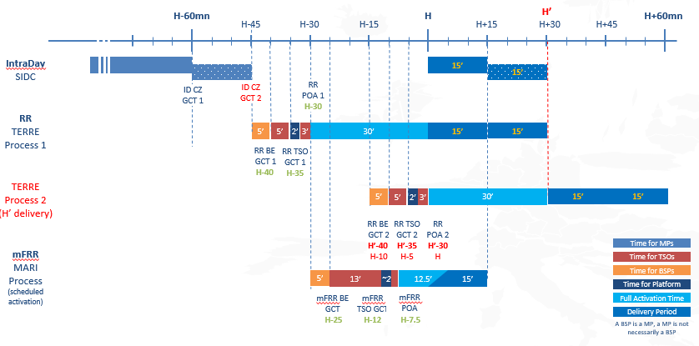
Back-up slides
Why 48-clearings options are not feasible?

