Slide 1
Collateral Improvements Proof of Concept

Slide 2

Collateral Improvements
Background of Collaterals in LT-Market
According to FCA Article 41(2), MPs must deposit financial collateral prior to the auctions
According to HAR Article 23, SAP must calculate and continuously update the credit limit for each registered MP:
Credit limit = collateral – outstanding payment obligations
When a bid is submitted by an MP, the so-called credit limit verification must be carried out in accordance with HAR Article 34:
Credit limit ≥= 0, with outstanding payment obligation = maximum payment obligation (MPO)
Increase in collateral requirements due to LTFBA, as auctions are held simultaneously for all BZBs.
Filter bids intelligently, but how?
Discussions on this topic already took place when amending HAR in 2023.
→ Outcome was to use a price cap based on DA and forward prices to limit the MPO (see HAR article 34(6) and (7)).
This approach can lead to an over-/underestimation of the market clearing price.
Late in the process N-SIDE proposed alternative approach to “filter bids”, but LTFBA go-live should not be jeopardised due to additional workload on collateral improvements.

Slide 3
Collateral Improvements
Current vs. New Approach
Current Approach: Bid Filtering prior to Auction Result Determination based on bid price and price cap
New Approach: Bid Filtering during Auction Result Determination based on marginal clearing prices
Bidding Period
Credit Limit Verification incl. Bid Rejection
Auction Results Determination
Maximum Payment Obligation based on Bid Prices and Price Cap
Warning to MP based on Maximum Payment Obligation
Does not include all bids
Bidding Period
Credit Limit Verification incl. Bid Rejection
Auction Results Determination
  Warning to MP based on Maximum Payment Obligation
  Credit Limit Verification no individual step anymore, but included in next step
  Collateral Budget considered as Boundary Condition in Optimization Problem
  Bid Rejection based on Marginal Clearing Prices

Slide 4
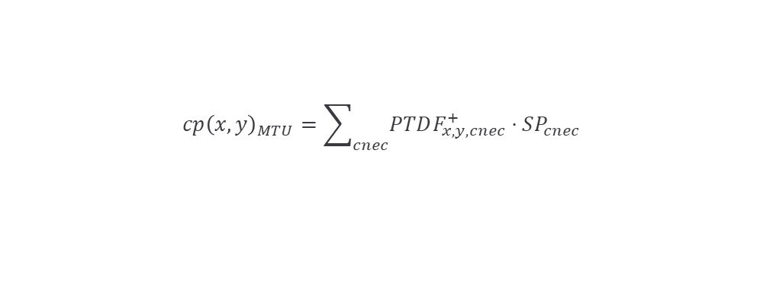
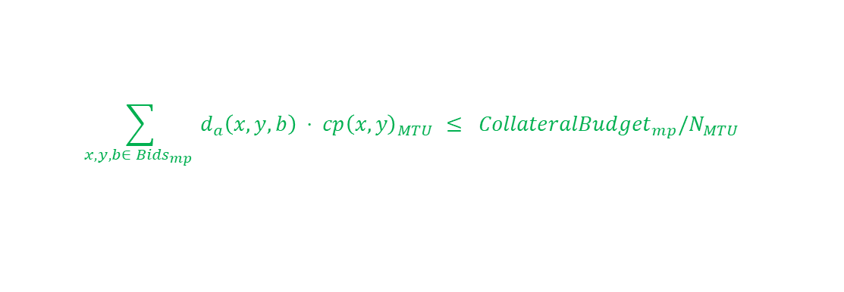
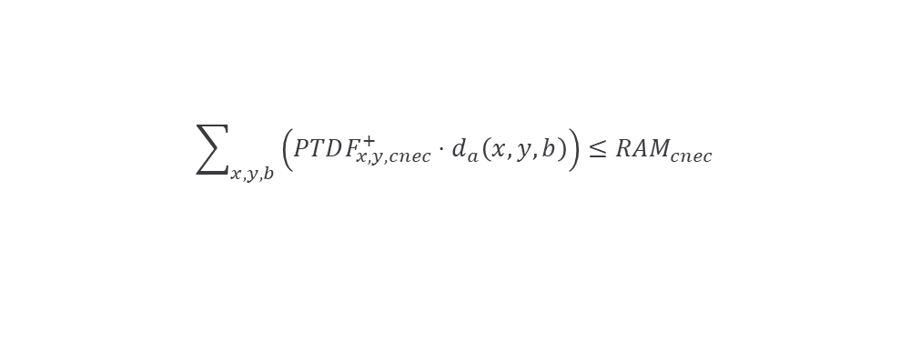
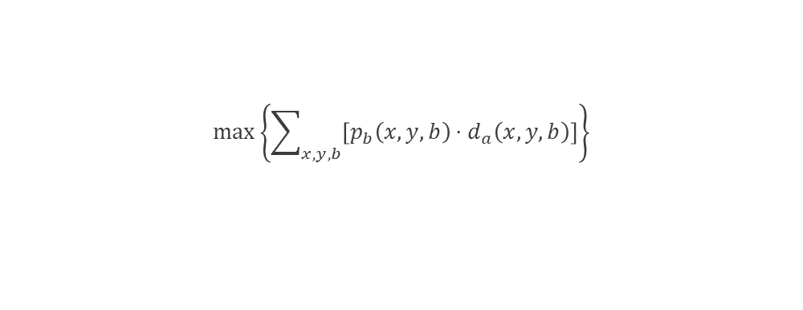
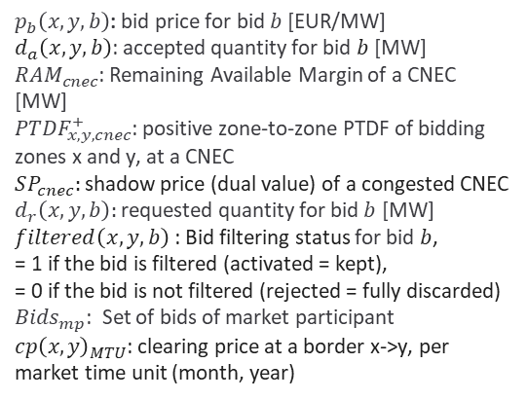
Collateral Improvements
New Approach: Exact market-based bid filtering based on the actual market prices
Optimization function
$$\max\left\{\sum_{x,y,b}{\left[p_{b}\left(x,y,b\right)⋅d_{a}\left(x,y,b\right)\right]}\right\}$$
Boundary conditions
$$\sum_{x,y,b}{\left(PTDF_{x,y,cnec}^{+}⋅d_{a}\left(x,y,b\right)\right)}≤RAM_{cnec}$$
No adjustments
$$cp{\left(x,y\right)}_{MTU}=\sum_{cnec}{PTDF_{x,y,cnec}^{+}}⋅SP_{cnec}$$
$p_{b}\left(x,y,b\right)$: bid price for bid $b$ [EUR/MW]
$d_{a}\left(x,y,b\right)$: accepted quantity for bid $b$ [MW]
$RAM_{cnec}$: Remaining Available Margin of a CNEC [MW]
$PTDF_{x,y,cnec}^{+}$: positive zone-to-zone PTDF of bidding zones x and y, at a CNEC
$SP_{cnec}:$shadow price (dual value) of a congested CNEC
$d_{r}\left(x,y,b\right):$requested quantity for bid $b$ [MW]
$filtered\left(x,y,b\right)$: Bid filtering status for bid $b$,
= 1 if the bid is filtered (activated = kept),
= 0 if the bid is not filtered (rejected = fully discarded)
${Bids}_{mp}$: Set of bids of market participant
$cp{\left(x,y\right)}_{MTU}$: clearing price at a border x->y, per market time unit (month, year)
Adjusted boundary condition
$$0≤d_{a}\left(x,y,b\right)≤{ d}_{r}\left(x,y,b\right) ⋅filtered\left(x,y,b\right)$$
New boundary condition for collateral check
$$\sum_{x,y,b∈ {Bids}_{mp} }{d_{a}\left(x,y,b\right) ⋅ cp{\left(x,y\right)}_{MTU} ≤ {CollateralBudget}_{mp}/N_{MTU} }$$
By using the actual Market Clearing Price (MCP) the problem of over-/underestimation of collaterals is solved

Slide 5
Collateral Improvements
Foreseen Approach for Determination of blocked Collaterals
Question: What amount of Collaterals should be blocked for LT-FB auction as Outstanding Payment Obligation?
Foreseen Approach:
MPs are enabled to define Reserved Collaterals during bidding period
If MP defines reserved collaterals with Reserved Collaterals ≤ Credit Limit
→ Reserved Collaterals will be blocked for LT-FB auction
If MP does not define reserved collaterals:
  SAP calculates Maximum Payment Obligation based on all bids at gate closure submitted for LT-FB auction
  If Maximum Payment Obligation ≤ Credit Limit:
  → Maximum Payment Obligation will be blocked for LT-FB auction
  If Maximum Payment Obligation > Credit Limit:
  → Credit Limit will be blocked for LT-FB auction
Foreseen Approach aims at giving MPs the possibility to self-determine blocked collaterals.
Feedback from MPs to this foreseen approach highly appreciated.

Slide 6
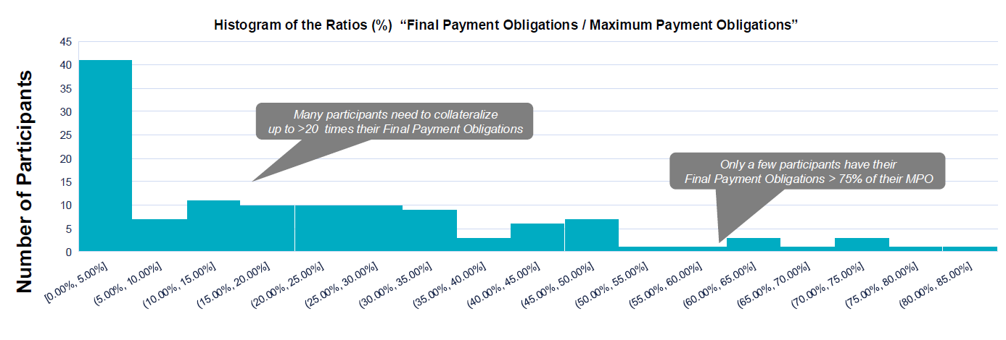
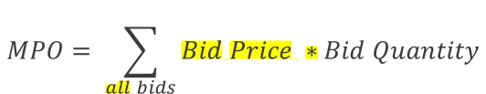
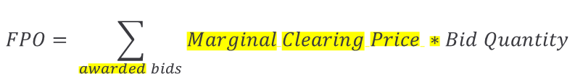
Collateral Improvements
Proof of Concept Results: Final vs. Maximum Payment Obligation
$$MPO= \sum_{all bids}{Bid Price ∗Bid Quantity}$$
Maximum Payment Obligation
Differences between maximum and final payment obligation highlighted
$$FPO= \sum_{awarded bids}{Marginal Clearing Price ∗Bid Quantity}$$
Final Payment Obligation
Final Payment Obligation in most cases much lower than Maximum Payment Obligation.

Slide 7
Collateral Improvements
Proof of Concept Results: Key Performance Indicators based on Bids for Yearly 2025 Auction
Ex-ante Bid Filtering with Price Caps Optimal Bid Filtering
KPI1: Auction Surplus -8% <<<-0.1%
KPI2: Settlements -12% -0.2%
KPI3: Paradoxically Filtered-Out Volumes -4,4% -99.5%
(compared to ex-ante bid filtering
without price caps)
KPI4: Traded Volumes -22% -0.02%
(All Core Borders)
Proof of Concept shows positive results regarding all investigated KPIs.

Slide 8


Collateral Improvements
HAR and SAP amendment
Currently TSOs and JAO are drafting the methodology amendments
Foreseen main HAR Amendments
  Article 23: Credit Limit
  Article 34: Credit Limit Verification
  Article 35: Auction Results Determination
Foreseen main SAP Amendments
  Article 41: Mathematical Formulation of the long-term Allocation Algorithm
Goal: Submit final amendment to ACER by end of May

